Slide 1
Data Science In Context
Ying Fang Lee

Slide 2

Data Science In Context
The key to effective data analysis lies in cleaning the data. The result of any statistical model or test analysis would not be accurate if the data is not clean. Raw data is often incomplete, inconsistent, or contains errors that can skew analysis and lead to inaccurate conclusions. Data cleaning involves identifying and rectifying issues like missing values, duplicates, outliers, and formatting inconsistencies. By ensuring the data is accurate, reliable, and standardized, you create a solid foundation for further analysis, making it easier to uncover meaningful patterns and insights. Without proper data cleaning, even the most sophisticated models may produce unreliable results.

Slide 3
Why Clean Data Matters
To get accurate insights from a given data set, the input raw data needs to maintain a level of quality. If the input values are incorrect then it will not lead to the correct output result even if the analysis process is correct.
Cleaning data also ensures that the data is structured in a way that can perform uniform transformations.

Slide 4
Raw Data Quality
Sometimes the quality of data is more difficult to process if the initial data is from user input which will have many unexpected answers.
Missing values on a dataset may also affect the approach on how to analyze a dataset
Categorical variables in stored as chatacters on a dataset also limits the kind of analysis that can be performed on a dataset.

Slide 5
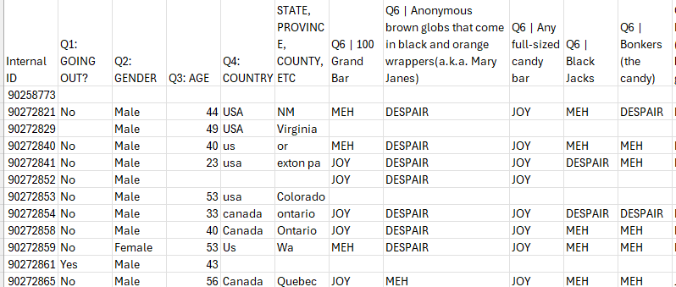
Example of Messy Data

Slide 6
Looking into Messy Data
Data has lots of missing data
User entry on the column State and Country
Categorical variables for the survey answers cannot be processed

Slide 7
Missing Values
Do we fill in the missing value or do we delete the row?
Why it matters:
If we ignore it the data result might be biased or inaccurate

Slide 8
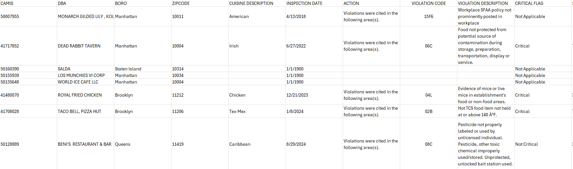
Example of Missing Data

Slide 9
Missing Data
This dataset comes from DOHMH New York City Restaurant Inspection Results where it contains the violation citations from every full or special program inspection conducted up to three years prior to the most recent inspection for restaurants and college cafeterias.
The missing values were for new establishments that have yet to had an inspection.
Do we remove it? Or do we keep it?

Slide 10
Techniques for Handling Missing Values
Imputation:
Deletion:
Forward/Backward Fill:
Filling missing values with the mean, median, or mode of the column.
Removing rows or columns with missing values (but be careful not to lose too much information).
Using previous or next values in time-series data to fill gaps.

Slide 11
Encoding Categorical Variables
To perform analysis, the variables will need to be in the right type. Statistical tests and machine learning models often require numerical input. Date/time analysis will require the variables be converted into Date objects so that sorting and transforming will be easier.

Slide 12
Example of categorical variables

Slide 13
Categorical Variables
This dataset comes from a survey conducted on what is the most popular Halloween candy. SO MUCH CANDY DATA, SERIOUSLY
The survey categorized the response into: “MEH”, “JOY”, “DESPAIR”
How can we analyze candy ranking by words?

Slide 14
Tchniques to Encoding Categorical Variables
One-Hot Encoding: Converting categorical variables into binary columns (e.g., creating a column for each country: US, UK, India).
Label Encoding: Converting categorical labels into numeric codes (e.g., male = 0, female = 1).

Slide 15

Normalization/Scaling
Many algorithms (e.g., k-NN, SVM, linear regression) perform better when features are on a similar scale

Slide 16
Example of Normalization/Scaling
name | releasedate | stars | star_rating | reviews | total_length
Geronimo Stilton #11 & #12 | 2008-08-04 | 5 out of 5 stars34 ratings | 5.0 | 34 | 140
The Burning Maze | 2018-05-01 | 4.5 out of 5 stars41 ratings | 4.5 | 41 | 788
The Deep End | 2020-11-06 | 4.5 out of 5 stars38 ratings | 4.5 | 38 | 123
Daughter of the Deep | 2021-10-05 | 4.5 out of 5 stars12 ratings | 4.5 | 12 | 676
The Lightning Thief: Percy Jackson, Book 1 | 2010-01-13 | 4.5 out of 5 stars181 ratings | 4.5 | 181 | 600
This dataset from Kaggle Audible Dataset aimed to understand how the audio book market has been growing over the years.
Should the book that has 5 stars rating but only 1 review be considered the same rating as another book that is also 5 stars with 1000 reviews?

Slide 17
Techniques to Normalization/Scaling
Min-Max Scaling: Re-scaling values to a range between 0 and 1.
Standardization (Z-score): Transforming data to have a mean of 0 and a standard deviation of 1.

Slide 18

Tidy Data
Tidy data is a concept introduced by Hadley Wickham in the context of data analysis, and it refers to organizing data in a consistent and structured way that makes it easier to clean, analyze, and visualize. Tidy data is important for data cleaning for several reasons, and understanding these benefits can help ensure that your data is in a form that’s ready for analysis with minimal effort.

Slide 19
Conclusion
Data cleaning is an essential part of the data analysis pipeline and can significantly improve model accuracy.
By handling missing data, encoding categorical variables, scaling numerical features, and creating new meaningful features, data scientists can build more reliable and effective machine learning models.
By organizing your data in a tidy format, you make it easier to clean, analyze, and visualize, ultimately leading to more accurate insights and better decisions.

